Slide 1
WALES ANTI-SLAVERYAWARENESS BRIEF INTRODUCTION
Notes:
This will equip professionals and others to have an awareness of the causes and signs of slavery of adults and children.
Explain to delegates that the blue blindfolded dragon is now the emblem that ensures quality and denotes any training/notes/information disseminated from the Wales Anti-Slavery Leadership Group.
It is worth mentioning at this point that the UN Convention on the Rights of the Child concludes that a child is any person under 18 years. This is because it is universally accepted that a child under 18 cannot consent to being exploited. The Sexual Offences act 2003 also states that 16/17 year olds cannot consent to exploitation – this is an age group that people often think can take care of themselves.

Slide 2
AIM:
To raise awareness about the exploitation of human beings
To understand your personal and organisation’s role and responsibility in tackling anti slavery
How you can contribute to making our country hostile to slavery.

Slide 3
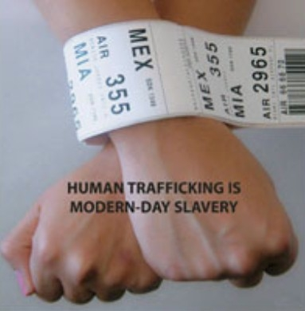
WHAT IS MODERN SLAVERY?
Notes:
The most simple explanation for ‘slavery’. Despite being outlawed on both sides of the Atlantic since 1805, the trade in human slaves has not stopped. It has simply been driven ‘underground’ by being prohibited.
Modern slavery includes: human trafficking, slavery, servitude, forced & compulsory labour
Human trafficking is the fastest growing form of slavery today and is prohibited under international law, as well as under the criminal laws of the United Kingdom and other countries.
The home office estimated in 2013 there were between 10,000 & 13,000 victims of modern slavery in UK
3

Slide 4
TYPES OF EXPLOITATION
These are fairly wide ranging and often include the following types of conduct:
Sexual Exploitation
Forced Labour
Forced criminality
Domestic Servitude
Organ harvesting
Child Exploitation.
Did you know
Labour exploitation is the most recorded form of slavery in the UK, accounting for 45 percent of recorded NRM cases (NCA, 2017)
Notes:
Sexual - frequently through prostitution where victims are placed into off-street brothels, forced to see many clients, and receive either little or no money.
Forced labour - where victims are forced to work very long hours and hand over all of their wages to their traffickers or controllers, e.g. domestic situations as sweatshop factories, construction sites, farm work, paving/ tarmacking, manufacturing, food processing, hospitality
Criminal – drugs, cannabis farming, organised crime, begging, benefit fraud, shoplifting/Theft, Credit card/ATM fraud, Selling Stolen Goods, DVD Pirating and Sales, pick pocketing
Domestic Servitude - victims who live and work in households where they are forced to work through threats of serious harm and physical and sexual assaults, ill treated, humiliated, long hours, unbearable conditions for little or no pay.
Organ harvesting - where victims are trafficked in order to sell their body parts and organs for transplant; eggs, kidneys, liver, eyes (China)
Children - children are amongst the most vulnerable victims; sometimes they are sold into forced labour or domestic work through debt bondage by family members where they are vulnerable to sexual or physical abuse.

Slide 5
NCA DATA 2017
5145 in total for the UK – a 35 % increase on 2016
Minor exploitation referrals increased by 65% on 2016 totals
47% female 52% male
Notes:
Adults = 3027
Children = 2118
3 recorded as transgender
REMIND – adults have to consent to take part in the NRM process.
5145 in total for the UK – a 35 % increase on 2016
Top 5 adult countries of origin =Albania/ Vietnam/ China / Nigeria/ Romania/ China
Top 5 Child countries of origin = UK , Albania/ Vietnam/ Sudan / Eritrea
Criminal – drugs, cannabis farming, organised crime, begging, benefit fraud
Organs – overies, kidneys, eyes

Slide 6
NCA DATA 2016
Top 5 adult countries of origin =Albania/ Vietnam/ China / Nigeria/ Romania/ China
Top 5 Child countries of origin = UK , Albania/ Vietnam/ Sudan / Eritrea
Criminal – drugs, cannabis farming, organised crime, begging, benefit fraud
Organs – ovaries, kidneys, eyes (China)
Notes:
REMIND – adults have to consent to take part in the NRM process.
3805 in total for the UK – a 17 % increase on 2015
Top 5 adult countries of origin =Albania/ Vietnam/ China / Nigeria/ Romania/ China
Top 5 Child countries of origin = UK , Albania/ Vietnam/ Afghanistan / Eritrea
Criminal – drugs, cannabis farming, organised crime, begging, benefit fraud
Organs – overies, kidneys, eyes (China)
2017 NCA data : From January – June 2017, there have been 109 referrals in Wales alone. Whereas in 2016, in the entire year there were 123 referrals.

Slide 7
FIRST RESPONDERS IN WALES
Police
UK Border Force
Home Office Immigration and Visas
Gangmasters Labour Abuse Authority (GLAA)
Local Authorities
Salvation Army
BAWSO
Barnardo’s
New Pathways
NSPCC
Notes:
The person completing the referral form is known as the first responder
Introduced in 2009 to ensure we’re meeting EU regs. on trafficking
CHAPS – Cardiff Health Access Practice Service
Consent needed to put in NRM form for adults only. Consent not needed for children
inform delegates that if they are from a first responder organisation that they have a duty Referrals into the NRM
Best for NRM form to be completed by 1st responder so that the quality of information provided gives the person a fighting chance to meet the criteria for the 45 day period.
The NRM is the national framework for the protection and assistance of victims of human trafficking adopted in the UK to:
• Identify victims of human trafficking;
• Provide them with the care they are entitled to;
• Provide them with the 45-day reflection and recovery period; and
• To ensure their human rights are respected.
Referrals into the NRM must be made by a ‘First Responder’ (e.g. Police, Social Services)

Slide 8
ACTIVITY
Discuss how you as a professional would recognise:
The signs/indicators of an enslaved child or adult victim?
What stops a victim from coming forward?.
Notes:
Tell the group to split their flipchart paper into 2 columns: Child Adult
Show the following slides to ensure they have covered everything
Indicators both physical & emotional
Health – physical, emotional & mental
The barriers that would stop a victim telling us what is happening to them.
A handout to be given to cover indicators.

Slide 9
Signs/ Indicators
Having no personal identification or passport/documents held by someone else
Lack of money/control over own finances or lack of access to earnings
Living/sleeping In the place of work
Any evidence of control of movement either as an individual or group
Limited contact with family& limited social contact
Others seeking to speak for the person you are trying to engage
Living or found in ‘degrading’ conditions
Children not in education.
Notes:
No passports or papers – traffickers are wise to this now and making sure they have false documents.
No days off or holiday time & imposed work conditions
Being restricted from freely leaving work
Appearing anxious/nervous around ‘Family Member’ or ‘Interpreter’
Employer providing transportation to/from work daily
Threats against family members
Signs of physical abuse
Excessive response Perception of being debt bonded

Slide 10
Signs/ Indicators
Children living with non relevant families
Signs of branding/ownership
Limited contact with family& limited social contact
Signs of physical abuse
Injuries apparently as a result of assault or ill treatment, as a result of work, or from restrains such as shackles or rope
Lack of access to medical care
Extreme reaction to authority or a dominant male or female (fear, shying away, overly suggestive)
Lifestyles they cannot afford, e.g. new mobile, clothes, money, food, etc.
Notes:
For young people being internally trafficked remember: Expensive lifestyles, e.g. new mobile, clothes, money, food, etc.
Older boyfriends (5 years plus)

Slide 11
Barriers to disclose
Lack of awareness that they are the victim of a crime
Unaware that help is there
Language barrier
Controlled movements
Fear of Repercussions
Accompanied by trafficker
Isolation.
Comparison of situation to a worse one
Immigration status
Involvement in criminal activity
Juju
Lack of trust of authorities
Self-blame
Stigma
‘Stockholm Syndrome’.
Notes:
Stockholm syndrome, or capture–bonding, is a psychological phenomenon in which hostages express empathy and sympathy and have positive feelings toward their captors, sometimes to the point of defending them. These feelings are generally considered irrational in light of the danger or risk endured by the victims, who essentially mistake a lack of abuse from their captors for an act of kindness.
Stockholm syndrome can be seen as a form of traumatic bonding, which describes “strong emotional ties that develop between two persons where one person intermittently harasses, beats, threatens, abuses, or intimidates the other
It suggests that the bonding is the individual’s response to trauma in becoming a victim. Identifying with the aggressor is one way that the ego defends itself. When a victim believes the same values as the aggressor, they cease to be a threat.
Inform delegates that there aer orgnaisaiotns that provide support and assistance to victims

Slide 12
Vulnerability
being susceptible to harm or injury
The offences are about Power, Control and Money.
There may be one or more offenders who abuse or exploit one or more victims
Notes:
There are many ways that a child or adult can be Vulnerable. This is not just about Modern Slavery, but also Child Sexual Exploitation, Domestic Abuse, Female Genital Mutual, Forced Marriage, Mental health, Prostitution and all aspects of Public Protection
The offences are about Power, Control and Money. It requires one or more offender to abuse or exploit one or more victims

Slide 13
power and control can be driven by a number of factors - look out for
What is the relationship between the offender and victim?
What are the circumstances that contribute to a person being a victim?
What does an offender gain from the relationship?
How is a Victim Controlled?
Notes:
What is the relationship between the offender and victim?
(Parental / Family / work related)
What are the circumstances that contribute to a person being a victim?
(Age / Mental health / Addictions / Social Ability)
What does an offender gain from the relationship?
(Control / Money / Belief Systems)
How is a Victim Controlled?
(Threats or Violence / Money / Addictions / Moral obligation)

Slide 14
If you have concerns …what do you do ?
Be curious and question relationships if you suspect anything of concern
Look to gain trust and confidence
Identify the risk
Ensure safety of victims

Slide 15
Simple message
Look, Understand and Help
All Public Services
Private Sector
Third Sector
Community

Slide 16
Potential Victim
If in doubt, treat as a victim first:
Priority
The safe recovery of the potential victim
Secondary
Immediate risk of harm Dial 999/ 101
Advice and Guidance – Modern Slavery Helpline 08000 121 700
Notes:
Crimes committed by the victim should also be secondary.
16

Slide 17

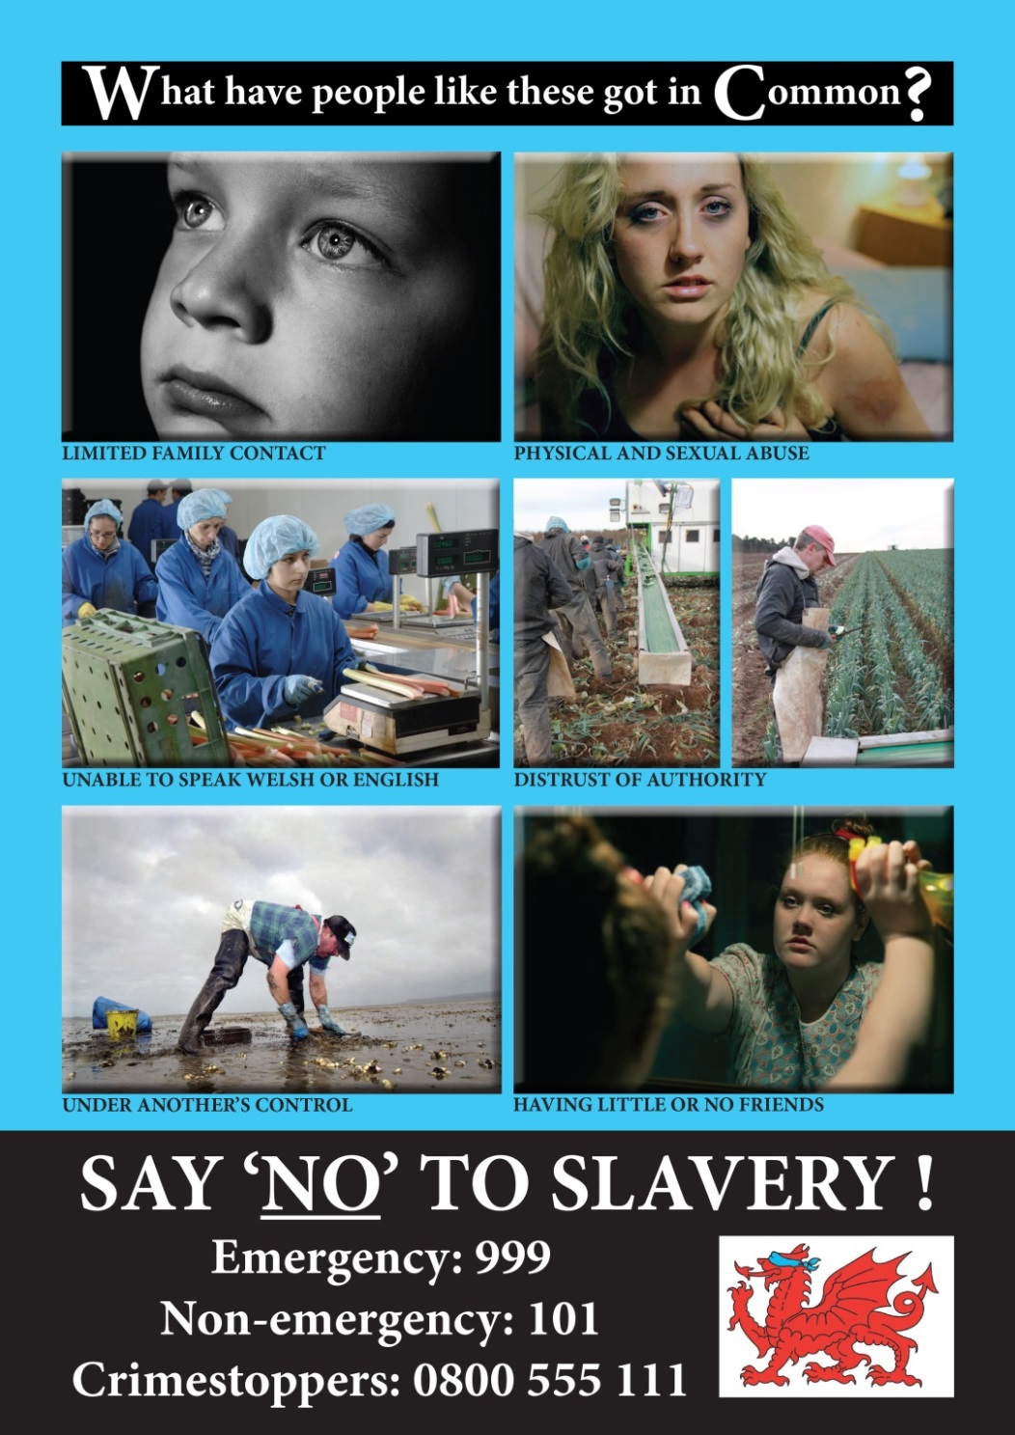
Modern Slavery Helpline: 08000 121 700
Notes:
These slides are intended to highlight the impactive use of images. There is however, no generic image of a trafficked victim and they don’t have labels saying they’ve been trafficked

Slide 18
‘SLAVERY TAKES PLACE IN YOUR COMMUNITY AND CAN BE STOPPED BY THE COMMUNITY’
YOU ARE A KEY PLAYER TO STOP IT !

